Slide 1
Data Exploration
By Eric&Kostas

Slide 2
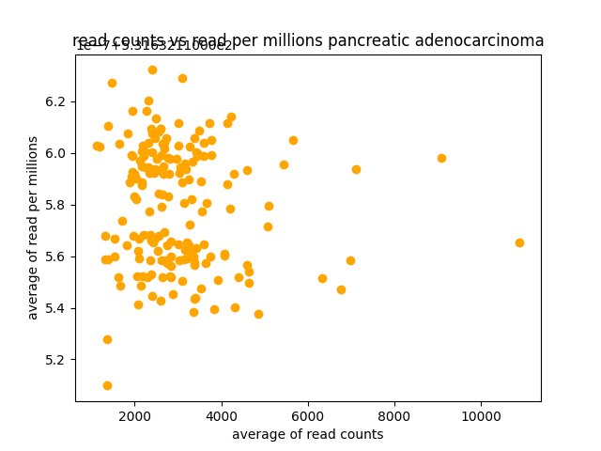
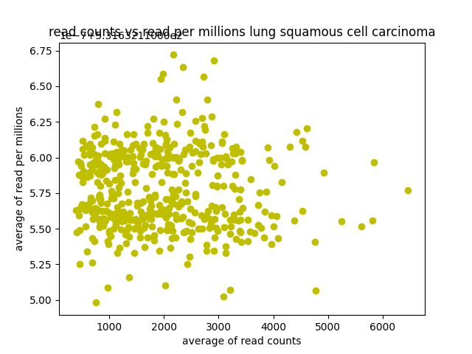
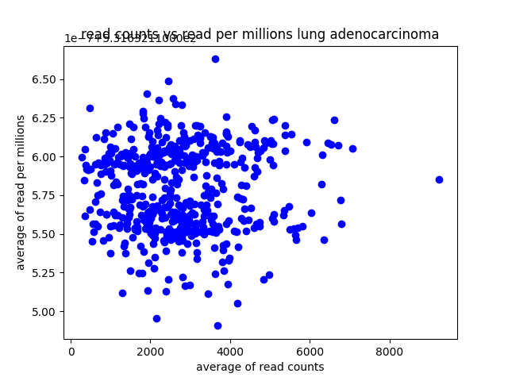
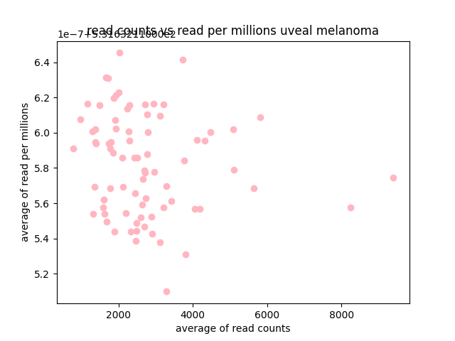
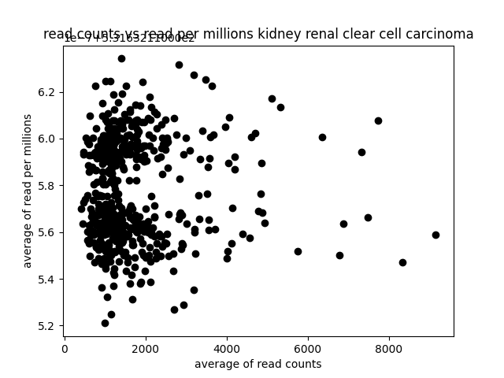
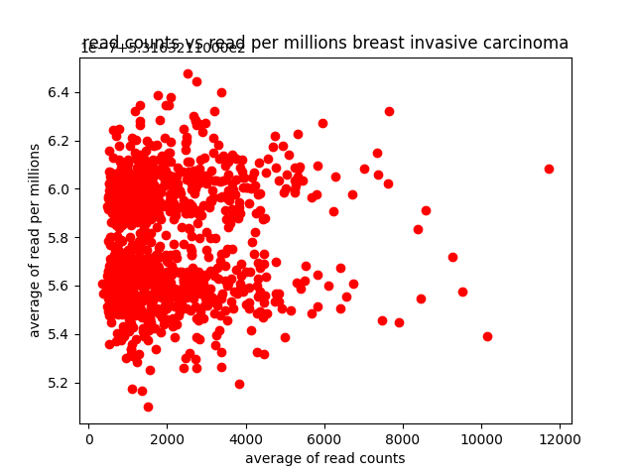
Average read_count V.S. reads_per_million

Slide 3
Scatterplots
Attempted to plot the data
Not sure if it shows anything
Averaged the numbers in the read_count and reads_per_million categories
Plotted them against each other
Can show some clustered differences. Need a higher dimensional plot

Slide 4
Normalization
Two ways:
preprocessing.StandardScaler()
Mean = 0, Std = 1
preprocessing.MinMaxScaler()
Normalize data into range of (0,1)
The choice of normalization methods should be made by comparing the performance of the final model.

Slide 5
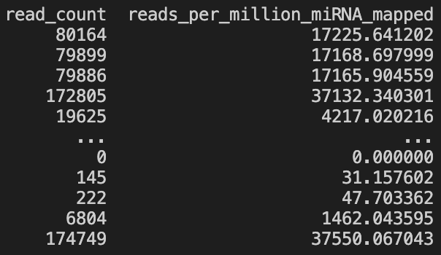
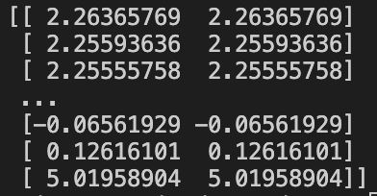
Result
StandardScaler
Mean: [2474.08825093 531.63211056]
Scale: [34320.52116695 7374.793965]
Original data

Slide 6
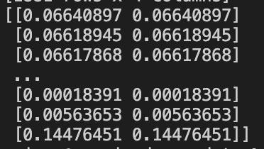
Result
MinMaxScaler
Original data

